Slide 1
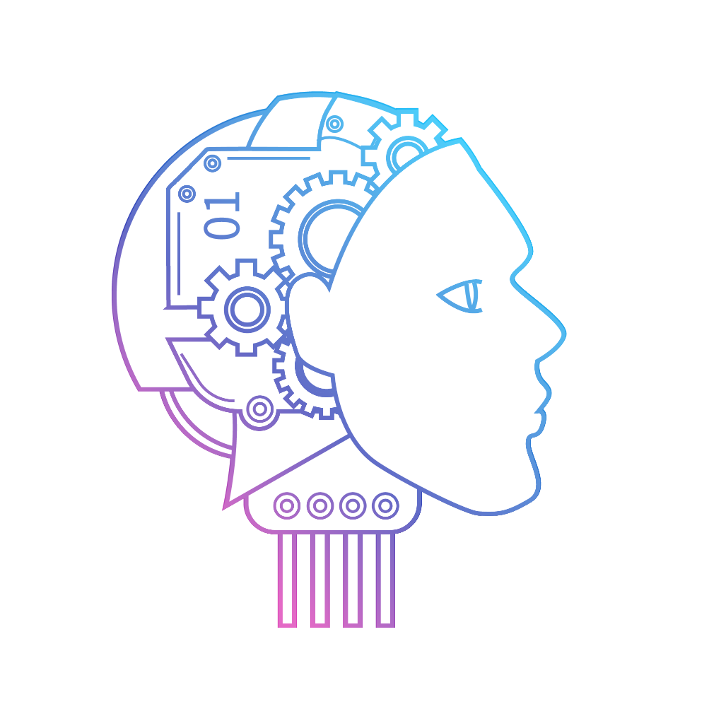

Desktop AI Voice Assistant
Presented By
18IT415, 18IT418, 18IT429

Slide 2
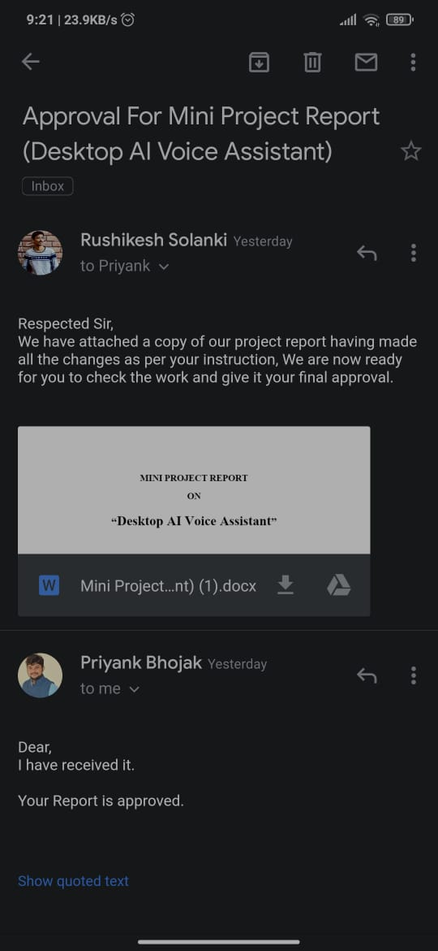
Approval

Slide 3
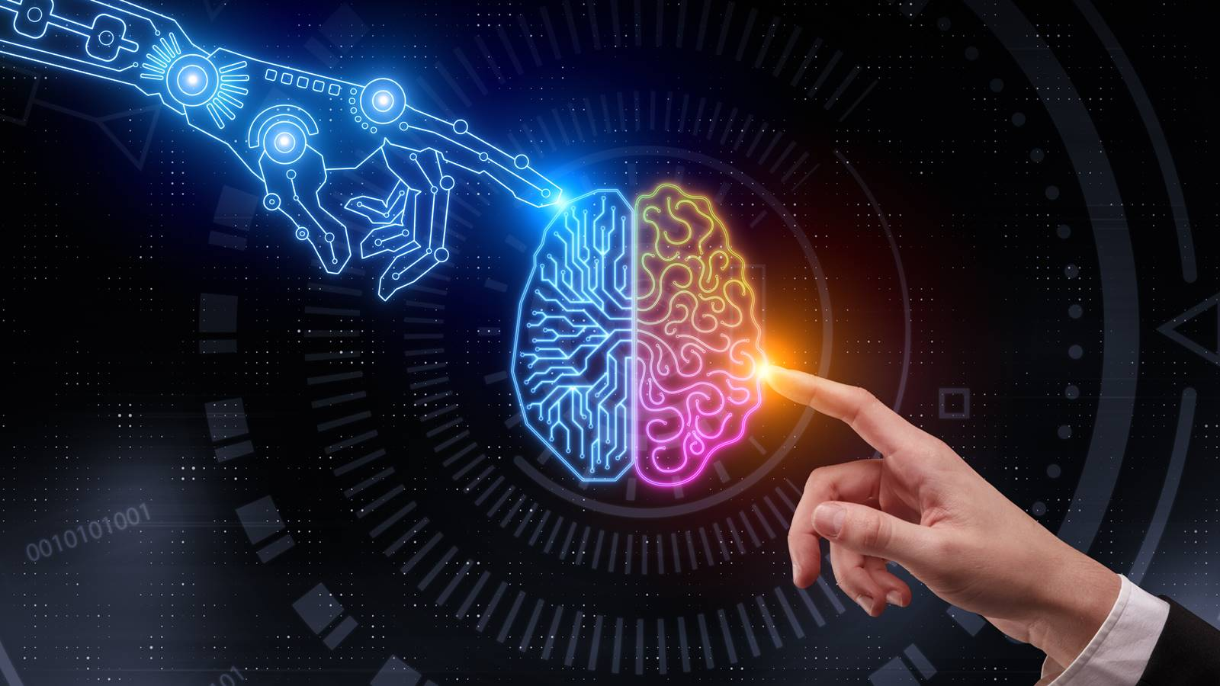
Contents
Introduction
Basic Concept Used
Hardware And Software Requirements
Working
Comparison
Modules And Features
User Interface
Conclusion

Slide 4
Introduction
Personal digital assistants are capturing a lot of attention lately. Chatbots are common in most commercial websites. With growing advancements in artificial intelligence, training the machines to tackle day-to-day tasks is the norm.
Voice based personal assistants have gained a lot of popularity in this era of smart homes
and smart devices. These personal assistants can be easily configured to perform many of your
regular tasks by simply giving voice commands.

Slide 5
Basic Concepts Used
The Working of voice assistant uses following principles :
Voice Conversation
Pyttsx3
For converting text to speech .
Speech_recognition
For converting given audio to text.
Inter Process Communication
To get Important information from other software application.

Slide 6
Hardware And Software Requirements
Hardware :
Desktop
Microphone
Speaker
Minimum 512MB RAM
Software :
Operating System should be Windows 7 or above.

Slide 7
Working - Three Layers
1. Speech to text
A piece of software used that converts audio to text.
It doesn’t understand just anything you might say.
2. Text Analysing
Converted text is just letters for computer.
A piece of software converts text to something that is understandable for computer.
Computer understand the command so assistant convert this text to command.

Slide 8
Working - Three Layers
It maps the words to functions and parameters to create a command that computer can understand.
Example of reminder.
3. Interpret Commands
In this layer that mapped computer command go to server through internet.
Simultaneously your speech evaluated locally.
A local recogniser communicate with server to judge whether command will be best handle locally or not.
Example of Play Music

Slide 9
Comparison
Function | Cortana | Our Assistant
Open Application | Yes | Yes
Change Wallpaper | No | Yes
Web Search Service | Bing Search Engine | Google Search Engine
Sending Email | Yes | Yes
Music Play | Local Library | Local Library
Accessing Videos from Youtube | No | Yes
Language | English ,French ,German ,Spanish etc | English

Slide 10
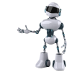
Modules
Speech Recognition
Data Access through API
Login & Register
Complete Voice Operated Queries
Accessing Information through webdriver
Local File Access

Slide 11

Speech Recognition
Used speechRecognition module
Recognizer recognizes the speech to give a response
Handling Exception
Used recognize_google function

Slide 12
Data Access Through API
Connect with different APIs and access data
used request library
Requests are used all over the web to receive data
If it’s successful then our assistant replied with necessary output
Functionalities: Get a weather for a location, Change Desktop Wallpaper, Tells you a Latest News, Tells you corona Information

Slide 13

Login And Register
Registration is Required to access the provided service
Login is required for authentication
Data are securely stored in database
BLOWFISH algorithm is used.
Ex . Word : meet
Encrypted form is
$2b$12$1PRMKFSp6DzvGFROcEyf0.aP4D22ILAAey4ReHuWqvtGtMmFgI9V

Slide 14


Complete Voice operated Queries
The task of sending emails and playing youtube videos require the user interaction physically
Physical interaction require the user to touch or type something , the assistant instead, will perform the whole process through just voice command.
Functionalities: Accessing Youtube Videos, Send Email, Tells You a Joke

Slide 15

Local File Access
Interact with the file system
OS module is Used
It provides a portable way of using operating system-dependent functionality
Functionalities: Launch System Application, Take Photo, Play Music

Slide 16


Accessing Information through Webdriver
Chromedriver-binary-auto package can be used
Selenium WebDriver uses to control Chrome
Functionalities : Queries From the Web, Dictionary Meaning

Slide 17





Other Features
Location search
Set Reminders
Shut down PC
Tells You a Current Time
Exit From the Application

Slide 18
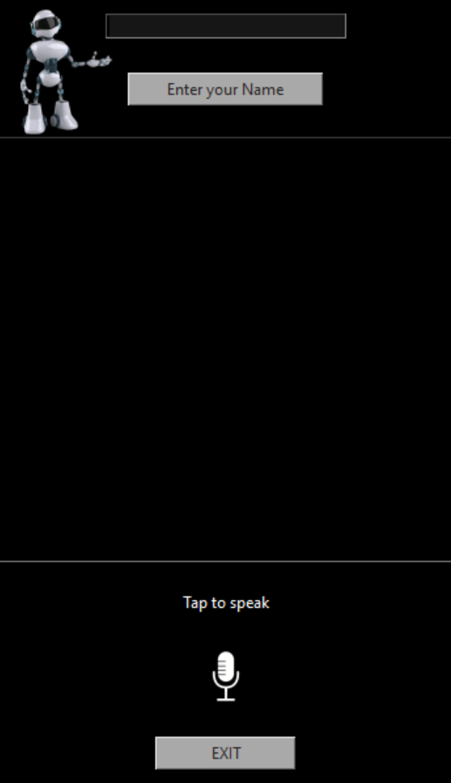
User Interface
Burpy
Name Input field
Enter name button
Output Field
Quit Button
Input speech button

Slide 19
Conclusion
The main aim of the project was to develop a Desktop Assistant that will be used to identify answers related to user submitted questions. To provide with sufficient information that is required by the user and to provide people a quick and easy way to have their questions answered.
A background research took place, which included an overview of the conversation procedure and any relevant desktop Assistant available.
The developed system is made on python programming language to be more specific Python 3.7.

Slide 20
Thank you

Slide 21
Any Questions?

